Slide 1
Continuity: Branch quiz

Slide 2
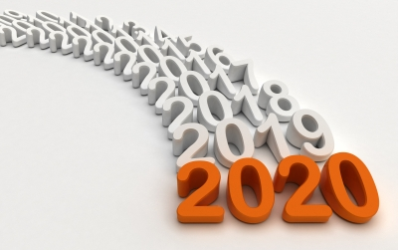
Round 1 - 2020
How much did Captain Tom Moore raise for the NHS? (to the nearest million)
How did Captain Tom Moore raise money?
What day and time were the 10 ‘Claps for the NHS’?
Which iconic singer-songwriter was credited with partially funding one of the successful Covid vaccines?
Which footballer campaigned for free school vouchers to be extended in 2020?
In December, Coronation Street celebrated which anniversary?
In February a powerful storm battered the UK. What was it called?
How old did the Queen become in 2020?
Boris Johnson and Carrie Symonds welcomed a new baby son in April, what is his name? (Bonus points if you know the two middle names)
Which new bank note entered circulation in February and features the face of artist JMW Turner?

Slide 3
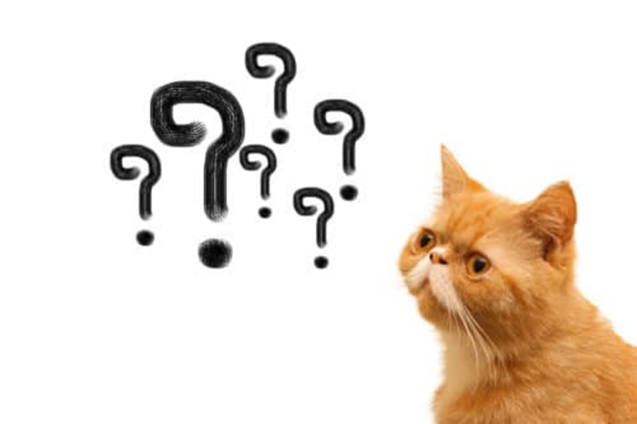
Round 2 – General Knowledge
What’s the chemical symbol for silver?
What is the smallest planet in our solar system?
What colour are the seats in the House of Commons?
What number is found in reference to their varieties on Heinz products?
What does the national public service broadcaster BBC stand for?
What in the animal kingdom is a doe?
What is the busiest airport in Britain called?
Who is next in line to the British throne after Queen Elizabeth II?
What number is a baker’s dozen?
How many keys are there on a piano?

Slide 4
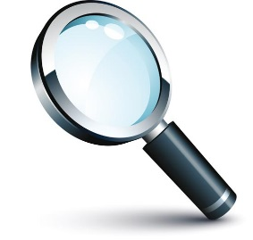
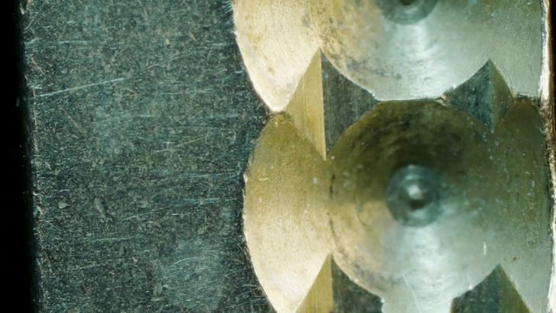
Round 3 – Close up round

Slide 5
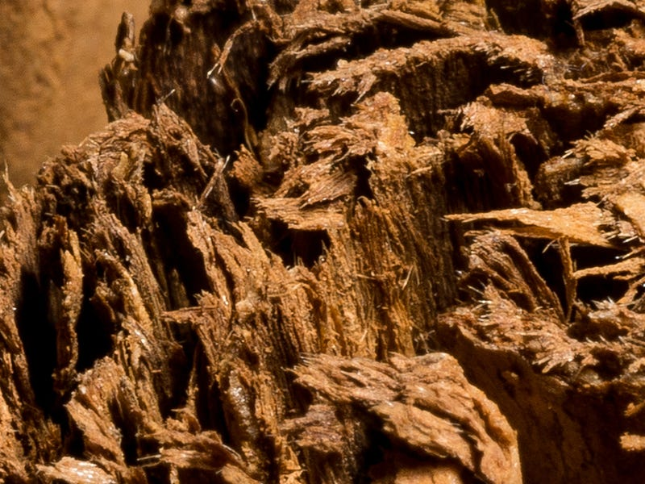
Close up round continued…

Slide 6
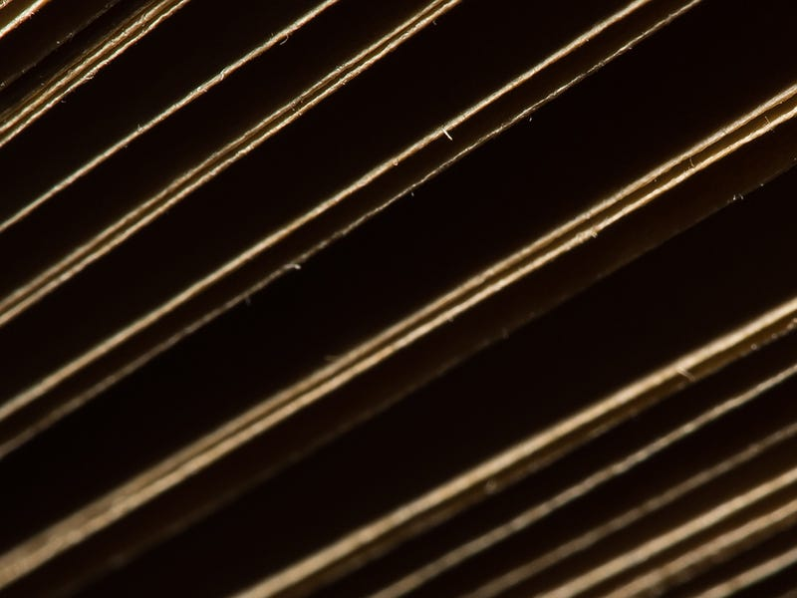
Close up round continued…

Slide 7
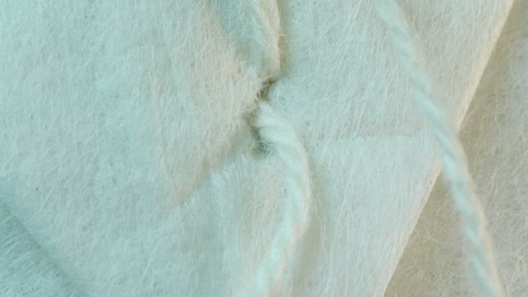
Close up round continued…

Slide 8
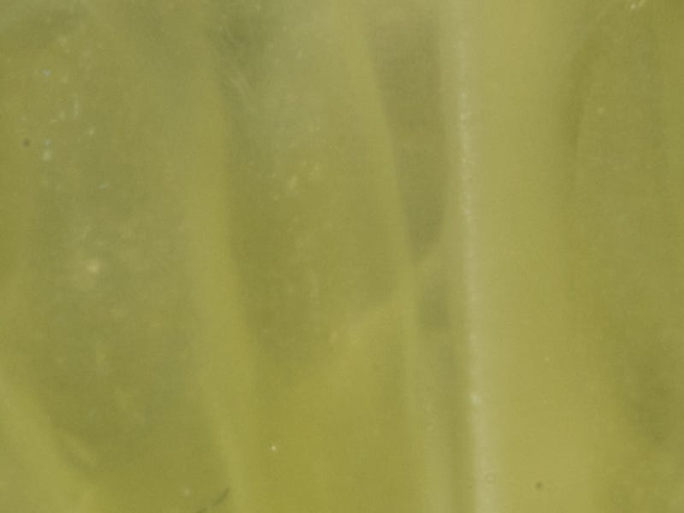
Close up round continued…

Slide 9
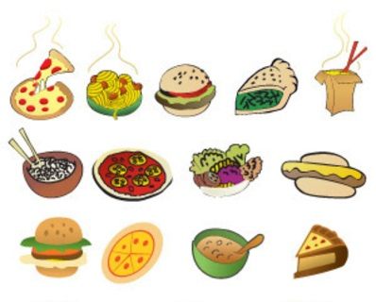
Round 4 – Food
Autumn King, Figaro and St Valery are all varieties of which vegetable?
Which 'T' is a Greek yoghurt containing cucumber?
Tempura is a fish or vegetables deep fried in batter best associated with which country?
Which southern Italian city is usually credited as the birthplace of the pizza?
Ataulfo, Alphonso and Keitt are varieties of what fruit?
In French cooking, which 'S' is a dish of eggs whisked and baked?
What type of pastry is used to make profiteroles?
Lincolnshire sausage is flavoured with which herb?
Mocha is a coffee usually flavoured with which substance?
In Italy, what is a Mortadella?

Slide 10
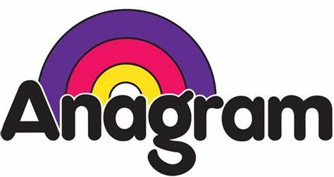
Round 5 – Food Anagrams
to ritual ale - French vegetable dish
hot toe inhaled - Classic English dish
abstracting hop area - A favourite dish for Italians
ape snack - Simply flour, eggs and milk
ma soak us - Staple dish in Greece
pinch his fads - A British staple
fleeces so bare - A meat stew
a legal title - Italian pasta
seems not - English dessert
mean trowel - Refreshing fruit

Slide 11
Answers
Round 1 – 2020
£32,795,065 - to the nearest million would be £33million
He walked 100 laps of his garden
Thursday at 8pm
Dolly Parton
60th
Storm Ciara
Wilfred Lawrie Nicholas Johnson
£20
Marcus Rashford
94
Potential for 12 points (with the bonus points from Question 7)
Round 2 – General knowledge
Ag
Mercury
Green
57
British Broadcasting Corporation
Female deer
London Heathrow
Prince Charles
13
88

Slide 12
Answers
Round 3 – Close up round
Key
Cinnamon (sticks)
Book pages
Teabag
Lime
Two points for each correct answer
Round 4 – Food and drink
Carrot
Tzatziki
Japan
Naples
Mango
Souffle
Choux
Sage
Chocolate
A sausage

Slide 13
Answers
Ratatouille
Toad in the hole
Spaghetti carbonara
Pancakes
Moussaka
Fish and chips
Beef Casserole
Tagliatelle
Eton Mess
Watermelon

